Slide 1
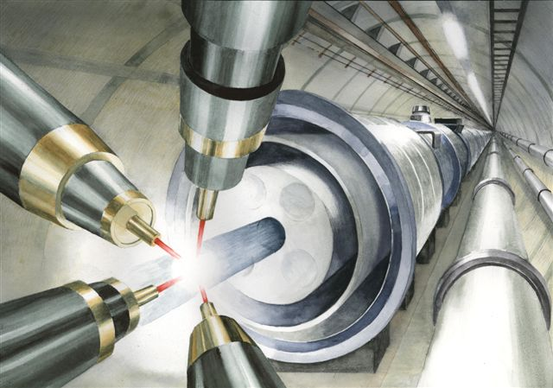
Prospect for
High Field Science
The Einstein Lecture
SIOM,Shanghai
September 6, 2013
T. Tajima
Norman Rostoker Professor, UCI
Deputy Director, IZEST
Albert Einstein Professor, CAS
Acknowledgments for Collaboration: G. Mourou, C. Barty, W. Brocklesby, K. Nakajima, R. Hajima, T. Hayakawa, S. Gales, K. Homma, M. Kando, S. Bulanov, B. Holzer, T. Esirkepov, , F. Krausz, D. Habs, B. LeGarrec, J. Miquel, W. Leemans, D. Payne, P. Martin, R. Assmann, R. Heuer, M. Spiro, B. Holzer, W. Chou, M. Velasco, J.P. Koutchouk, M. Yoshida, T. Massard, G. Cohen-Tannoudji, V. Zamfir, T. Ebisuzaki, R.X. Li, X. Q. Yan, K. Abazajian, S. Barwick, J. Limpert, D. Payne, K. Koyama, A. Suzuki, Y. Okada, K. Ishikawa, N. Rostoker

Slide 2
Conclusions
• High field science frontier expanding
• Laser-driven accelerators for high energy physics collider in particular
• Large fluence, high efficiency of CAN lasers important for many new scientific and societal applications
• CAN laser = smart laser : highly controllable
• Higgs factory by γ-γ collider emerging
• New weak-coupling field search of vacuum by laser
• Nuclear transmutation by laser-driven neutron sources, ADS, ADR
• Non-contact detection of nuclear isotopes via laser Compton gamma rays (Fukushima)
Other industrial applications (auto-industry, chemical industry, mechanical industry, medical, etc.) with large fluence and high efficiency lasers
EHECR <--> terrestrial laser acceleration

